Slide 1
Homework Assignment #3
Packet Capture and Analyze

Slide 2
Outline
Raw Socket
Socket API
About ioctl
Homework Assignment #3

Slide 3
Raw Socket
Lots of tools or libraries exist for packet capture & analyze
  Sniffer, Pcap,…
However, in this homework, you must utilize the operating system services to capture and analyze packets
  Use ioctl() function to change a NIC’s flag
    Capture all packets passing the NIC
  Use raw socket to obtain layer 2 & layer 3 information
    Analyze all captured packets

Slide 4
Raw Socket
Usually, sockets are used to build applications on top of a transport protocol
  Stream sockets (TCP) and Datagram sockets (UDP)
Some applications need to access a lower layer protocol
Using RAW socket, the packets you receiving are not modified
Constrain
  No port number: system forward raw packets to suitable raw socket
  In Linux, raw socket can only be used by root

Slide 5
Outline
Raw Socket
Socket API
About ioctl
Homework Assignment #3

Slide 6
Socket API (cont.)
socket
  Create a descriptor for use in network communication
#include <sys/type.h>
#include <sys/socket.h>
int socket(int domain, int type, int protocol);
EX: fd=socket(PF_PACKET,SOCK_RAW,htons(ETH_P_ALL));
domain:
PF_UNIX: Protocol Family is UNIX
(for local communication)
PF_INET: Protocol Family is IPv4
PF_INET6:Protocol Family is IPv6
type:
SOCK_STREAM: TCP
SOCK_DGRAM: UDP
SOCK_SEQPACKET: SCTP
SOCK_RAW
protocol:
0 ~ 255
  (ref. /etc/protocols. The value 0 may be used to select a default protocol from the selected domain and type)
  htons(ETH_P_ALL) : all protocols are received
return value:
successful:
    return a non-negative integer, socket descriptor (sd)
otherwise return -1

Slide 7
Socket API (cont.)
htons
  Convert the unsigned short integer hostshort from host byte order to network byte order
htonl
  Convert the unsigned integer hostlong from host byte order to network byte order
#include <arpa/inet.h>
uint16_t htons(uint16_t hostshort);
EX: address.sin_port = htons(5555);
#include <arpa/inet.h>
uint32_t htonl(uint32_t hostlong);
EX: address.sin_addr.s_addr = htonl(0x7F000001);

Slide 8
Socket API (cont.)
bzero
  Set the first n bytes of the area starting at s to zero (bytes containing '\0')
inet_addr
  Convert the Internet host address cp from IPv4 numbers-and-dots notation into binary data in network byte order
#include <string.h>
void bzero(char *s, int n);
EX: bzero(&Address, sizeof(Address));
#include <sys/socket.h>
#include <netinet/in.h>
#include <arpa/inet.h>
in_addr_t inet_addr(const char *cp);
EX: address.sin_addr.s_addr = inet_addr(“140.120.15.242”);

Slide 9
Socket API (cont.)
bind
  Bind a local IP address and protocol port to a socket
#include <sys/socket.h>
#include <netinet/in.h>
int bind(int sd, struct sockaddr *address, int address_length);
EX:
struct sockaddr_in Address;
bind(sock,(struct sockaddr *)&Address, sizeof(Address))

Slide 10
Socket API (cont.)
recvfrom
  Receive a message from a socket
sendto
  Send a message on a socket
#include <sys/socket.h>
int recvfrom(int sd, void *buffer, int message_length, int flags,
struct sockaddr *address, int *address_length);
EX: byte_recv = recvfrom(sock, buffer, sizeof(buffer), 0, (struct sockaddr *)&Address, &sizeof(Address));
#include <sys/socket.h>
int sendto(int sd, void *buffer, int message_length, int flags,
struct sockaddr *address, int address_length);
EX: byte_sent = sendto(sock, buffer, sizeof(buffer), 0, (struct sockaddr *)&Address, sizeof(Address));

Slide 11
Socket API (cont.)
close
  Terminate communication and deallocate a descriptor
#include <unistd.h>
int close(int sd);
EX: close(sock);

Slide 12
Outline
Raw Socket
Socket API
About ioctl()
Homework Assignment #3

Slide 13
About ioctl()
Ioctl()
  Manipulates the underlying device parameters of special files
#include <sys/ioctl.h>
int ioctl(int fd, unsigned long com, char *argp)
EX: ioctl(fd,SIOCGIFFLAGS, *ifreq );
Command | Third argument | Description
SIOCGIFCONF | struct ifconf * | Retrieve list of interface configuration
SIOCGIFFLAGS | struct ifreq * | Get interface flags
SIOCGIFMETRIC | struct ifreq * | Get interface metric
SIOCSIFFLAGS | struct ifreq * | Set interface flags
SIOCSIFMETRIC | struct ifreq * | Set interface metric

Slide 14
About ioctl() (cont.)
struct ifreq
{
char ifr_name[IFNAMSIZ]; /* Interface name */
union {
struct sockaddr ifr_addr;
struct sockaddr ifr_dstaddr;
struct sockaddr ifr_broadaddr;
struct sockaddr ifr_netmask;
struct sockaddr ifr_hwaddr;
short ifr_flags;
int ifr_ifindex;
int ifr_metric;
int ifr_mtu;
struct ifmap ifr_map;
char ifr_slave[IFNAMSIZ];
char ifr_newname[IFNAMSIZ];
char * ifr_data;
};
}

Slide 15
About ioctl() (cont.)
SIOCGIFFLAGS, SIOCSIFFLAGS
  Get or set the active flag word of the device
contains a bit mask of the following values:
Device flags
IFF_UP Interface is running.
IFF_BROADCAST Valid broadcast address set.
IFF_DEBUG Internal debugging flag.
IFF_LOOPBACK Interface is a loopback interface.
IFF_POINTOPOINT Interface is a point-to-point link.
IFF_RUNNING Resources allocated.
IFF_NOARP No arp protocol, L2 destination address not set.
IFF_PROMISC Interface is in promiscuous mode.
IFF_NOTRAILERS Avoid use of trailers.
IFF_ALLMULTI Receive all multicast packets.
IFF_MASTER Master of a load balancing bundle.
IFF_SLAVE Slave of a load balancing bundle.
IFF_MULTICAST Supports multicast
IFF_PORTSEL Is able to select media type via ifmap.
IFF_AUTOMEDIA Auto media selection active.
IFF_DYNAMIC The addresses are lost when the interface goes down.
IFF_LOWER_UP Driver signals L1 up (since Linux 2.6.17)
IFF_DORMANT Driver signals dormant (since Linux 2.6.17)
IFF_ECHO Echo sent packets (since Linux 2.6.25)

Slide 16
Outline
Raw Socket
Socket API
About ioctl
Homework Assignment #3

Slide 17
Homework Assignments #3
Basic:
  Capture and analyze some packets’ information (70 pts)
Advanced: (30 pts)
  Write a program that build a (TCP or UDP) packet with fake source IP address and port number , then send the packet
  Write a program that receive a (UDP or TCP) packet and modify the payload ,then send the packet

Slide 18
Homework Assignment #3 Basic: (70 pts)
    In this work, you are asked to use raw socket to obtain layer 2 & layer 3 information and analyze all captured packets
  HW3-1 (20 pts)
    Write a program that capture 200 packets and analyze
  HW3-2 (25 pts)
    Write a program that capture 5 UDP packets
      Print out the information for each captured packet
      Destination belongs to you
  HW3-3 (25 pts)
    Write a program that capture 5 TCP packets
      Print out the information for each captured packet
      Source or destination not belong to you

Slide 19
Flowchart
Start
struct ifreq ethreq;
//ifreq in <net/if.h>
unsigned char buffer[ETH_FRAME_LEN];
//frame could be placed at this buffer
Setup
interface
Header:
#include <sys/types.h>
#include <sys/socket.h>
Define:
int socket(int domain,int type,int protocol)
You need defining a Raw Socket to get L2,L3 information.
Ex: fd=socket(PF_PACKET,SOCK_RAW,htons(ETH_P_ALL));
Establish
socket
Header:
#include <sys/ioctl.h>
Define:
int ioctl(int fd, unsigned long com, char *argp)
Using command SIOCGIFFLAGS to get the original flag
EX:
strncpy(ethreq.ifr_name,"eth0",IFNAMSIZ);
ioctl(fd,SIOCGIFFLAGS,&ethreq);
Get
interface
flag

Slide 20
Flowchart (cont.)
Define in header file <net/if.h>
#define IFF_PROMISC 0x100 /*receive all packets */
You need to set NIC’s flag to IFF_PROMISC
EX:
ethreq.ifr_flags|=IFF_PROMISC;
ioctl(fd,SIOCSIFFLAGS,&ethreq);
P.S. before program terminated, remember to restore NIC’s flag -- ethreq.ifr_flags&=~IFF_PROMISC;
Set
promiscuous
mode
EX:
recvfrom(fd, buffer, ETH_FRAME_LEN, 0, NULL, NULL);
Receive
packets
IP
ARP
Others
….
Analyzing
&
Filtering
TCP
UDP
ICMP
….
Loop
receive

Slide 21
Data Structure
Define structure
  #include <linux/if_ether.h> //for ethernet header
    struct ethhdr{
    unsigned char h_dest[ETH_ALEN];
    unsigned char h_source[ETH_ALEN];
    unsigned short h_proto;
    }
  #include <linux/ip.h> //for IP header
  struct iphdr {
    unsigned int ihl:4;
    unsigned int version:4;
    unsigned char tos;
    unsigned short tot_len;
    unsigned short id;
    unsigned short frag_off;
    unsigned char ttl;
    unsigned char protocol;
    unsigned short check;
    unsigned int saddr;
    unsigned int daddr;
    }

Slide 22
Data Structure
Define structure
  #include <linux/udp.h> //for udp header
    struct udphdr{
    __be16 source;
    __be16 dest;
    __be16 len;
    __sum16 check;
    }
  #include <linux/tcp.h> //for tcp header
    struct tcphdr{
    __be16 source;
    __be16 dest;
    __be32 len;
    __be32 check;
    ．
    ．
    ．

Slide 23
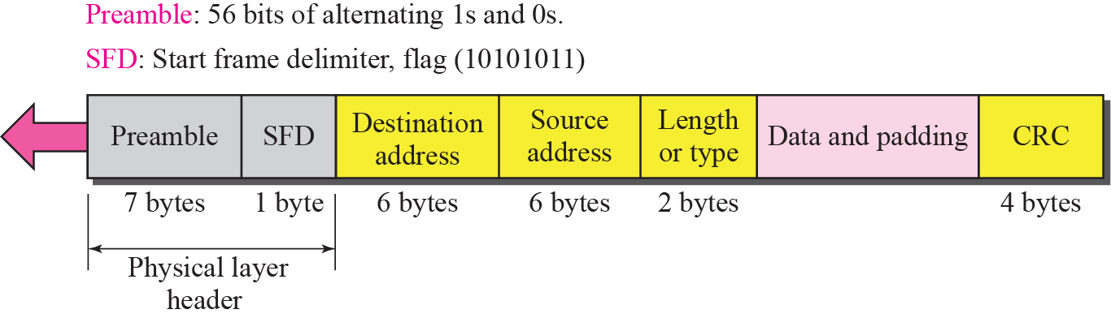
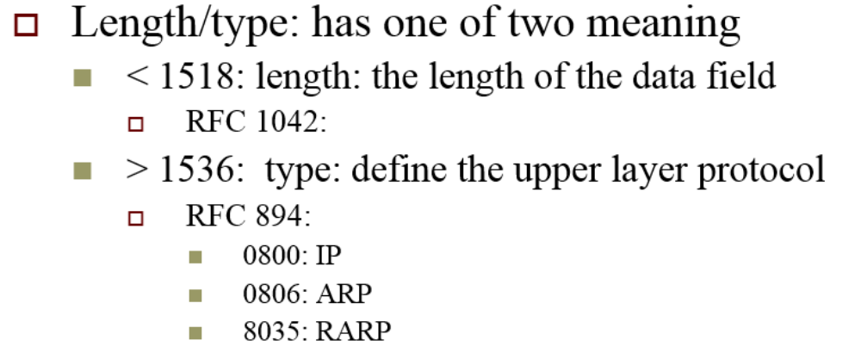
Ethernet Frame Analysis
If length/type is greater than 1536, then PDU means the protocol used by “Data and Padding”.

Slide 24
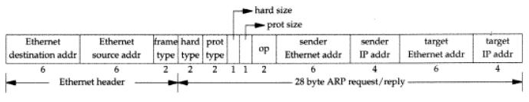
ARP/RARP Packet Analysis
ARP and RARP have same format.
If frame type is 0x0806, data and padding is ARP
If frame type is 0x8035, data and padding is RARP

Slide 25
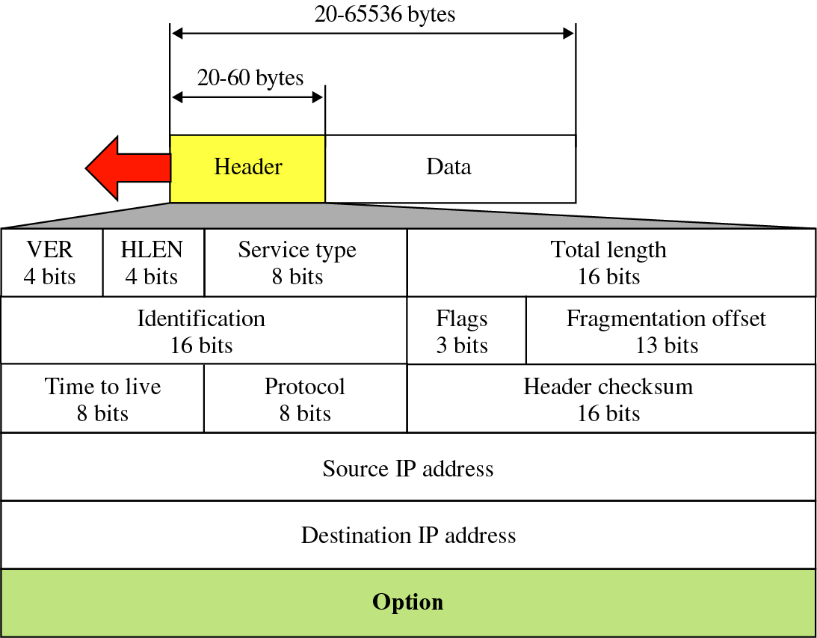
IP Packet Analysis
If type is 0x0800, data and padding is IP packet
Protocol could be 1(ICMP), 2(IGMP), 6(TCP), 7(UDP).

Slide 26
int main(int argc, char *argv[]){
  struct ethhdr *peth;
  struct iphdr *pip;
  char *ptemp;
  .....
  struct ifreq ifr;
  strncpy(ifr.ifr_name, "eth0", IFNAMSIZ);
  if(ioctl(sock,SIOCGIFFLAGS,&ifr) == -1)
  {
  perror("ioctl");exit(1);
  }
  ifr.ifr_flags |= IFF_PROMISC;
  if(ioctl(sock, SIOCSIFFLAGS, &ifr) == -1)
  {
  perror("ioctl");exit(1);
  }
}

Slide 27
for(;;)
{
r = recvfrom(sock, buf, sizeof(buf), 0, NULL, NULL);
ptemp = buf;
peth = (struct ethhdr *)ptemp; //ethernet header
switch(ntohs(peth->h_proto))
{
case 0x0800:
ip_counter++;
break;
case 0x0806:
arp_counter++;
break;
case 0x8035:
rarp_counter++;
break;
}

Slide 28
ptemp += sizeof(struct ethhdr);
pip = (struct iphdr *)ptemp;
switch(pip->protocol)
{
case IPPROTO_TCP: tcp_counter++;
break;
case IPPROTO_UDP:
udp_counter++;
break;
.
.
.

Slide 29
Exercise 3-1 (20 pts)
  Capture 200 packets and print out a summary of the packets
Format: ./capture
ex:
$ ./capture
  ------statistics------
  IP :75
  ARP :3
  RARP :3
  TCP :6
  UDP :60
  ICMP :0
  IGMP :0
  -----finish-----

Slide 30
Exercise 3-2 (25 pts)
Capture 5 UDP packets
  Print out the information for each captured packet
  Destination belongs to you
Format:
  packet 1:
    Source MAC address: 00:0E:6A:D3:B3:1E
    Destination MAC address: 00:E0:18:ED:D7:13
    IP->protocol = UDP
    IP->src_ip = 220.130.208.127
    IP->dst_ip = 220.130.208.128
    Src_port =2345
    Dst_port =64
    ．
    ．
    ．
#include <linux/udp.h>

Slide 31
Exercise 3-3 (25 pts)
Capture 5 TCP packets
  Print out the information for each captured packet
  Source or destination not belong to you
Format:
    packet 1:
    Source MAC address: 00:0E:6A:D3:B3:1E
    Destination MAC address: 00:E0:18:ED:D7:13
    IP->protocol = TCP
    IP->src_ip = 220.130.208.127
    IP->dst_ip = 220.130.208.129
    Src_port =2345
    Dst_port =64
    ．
    ．
    ．
#include <linux/tcp.h>

Slide 32
Homework Assignment #3: Advanced (30 pts)
    In this work, you are asked to use raw socket to fake some specified fields in packets
  HW3-4 (15 pts)
    Write a program that build a (TCP or UDP) packet with fake source IP address and port number , then send the packet
      Such as IP spoof attack
  HW3-5 (15 pts)
    Write a program that receive a (UDP or TCP) packet and modify the payload ,then send the packet

Slide 33
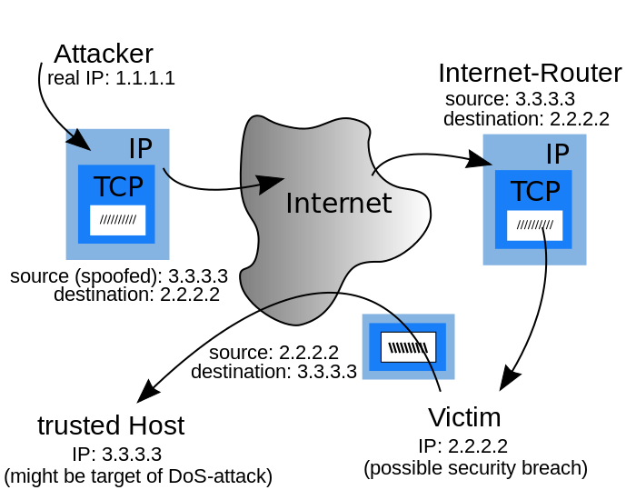
IP Spoof Attack

Slide 34
IP Spoof Attack
  You need to fake an ip address and send 5 packets to any other real ip address.
Format
  Ex: sudo ./spoof.out 3.3.3.3 4950 2.2.2.2 1111
Then, you need to check those fake packets by three methods.
  Use linux instruction
    tcpdump –i lo –nn
  Use wireshark to listen packets
  Use basic part program to observe packets
Source
ip address
(spoofed)
Source
port number
(spoofed)
Destination
ip address
Destination
port number

Slide 35
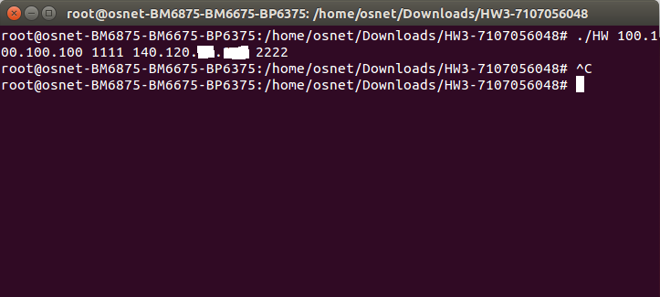
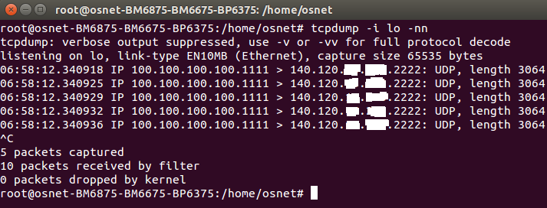
Ex: Use tcpdump
  sudo ./HW.o 100.100.100.100 1111 140.120.x.x 2222
Fake address

Slide 36
HW3-5 example
Source IP address = 100.100.100.100
Dest IP address = 200.200.200.200
IP protocol = UDP
Source port number = 1234
Dest port number = 4567
Data = “test123”
Incoming packet
Source IP address = 150.150.150.150
Dest IP address = 200.200.200.200
IP protocol = UDP
Source port number = 6484
Dest port number = 4567
Data = “test456789”
outgoing packet

Slide 37
Turn in
Deadline
2019/12/4 11:59:59 PM
Upload to i-learning
File name
  HW3_ID.zip
    Source code
    Word
If you don’t hand in your homework on time, your score will be deducted 10 points every day.

Slide 38
TA
Name: 蘇慶軒
Email: khs011342@gmail.com
  Title format: TCP/IP HW# - [your name]
Lab: OSNET(1001)

Slide 39
Ref
http://blog.roodo.com/thinkingmore/archives/554037.html
https://wirelessr.gitbooks.io/working-life/content/sockraw_with_tcpdump.html
http://www.tenouk.com/Module43a.html

Slide 40

ANY QUESTION?

